Slide 1
Near Optimal Work-Stealing Tree for Highly Irregular Data-Parallel Workloads
Aleksandar Prokopec
Martin Odersky

Slide 2
Near Optimal Work-Stealing Tree for Highly Irregular Data-Parallel Workloads
Irregular Data-Parallel
Aleksandar Prokopec
Martin Odersky

Slide 3
Uniform workload
(0 until 10000000) reduce (+)

Slide 4
Uniform workload
(0 until 10000000) reduce (+)
sum = sum + x

Slide 5
Uniform workload
(0 until 10000000) reduce (+)
sum = sum + x
cycles
…
N

Slide 6
Baseline workload
for (0 until 10000000) {}
cycles
…
N

Slide 7
Irregular workload

Slide 8
Irregular workload
cycles
N

Slide 9
Irregular workload
for {
x <- 0 until width
y <- 0 until height
} image(x, y) = compute(x, y)
cycles
N

Slide 10
Irregular workload
for {
x <- 0 until width
y <- 0 until height
} image(x, y) = compute(x, y)
image(x, y) = compute(x, y)
cycles
N

Slide 11
Workload function
workload(n) – work spent on element n after the data-parallel operation completed

Slide 12
Workload function
workload(n) – work spent on element n after the data-parallel operation completed
Could be…
for {
x <- 0 until width
y <- 0 until height
} img(x, y) = compute(x, y)
Runtime value
dependent

Slide 13
Workload function
workload(n) – work spent on element n after the data-parallel operation completed
Could be…
Execution-schedule
dependent
for (n <- nodes)
n.neighbours += new Node

Slide 14
Workload function
workload(n) – work spent on element n after the data-parallel operation completed
Could be…
for ((x, y) <- img.indices)
img(x, y) = sample(
x + random(),
y + random()
)
Totally random

Slide 15
Data-parallel scheduler
Assign loop elements to workers
without knowledge about the workload function.

Slide 16
Data-parallel scheduler
Assign loop elements to workers
without knowledge about the workload function.
Linear speedup for the baseline workload

Slide 17
Data-parallel scheduler
Assign loop elements to workers
without knowledge about the workload function.
Linear speedup for the baseline workload
Optimal speedup for irregular workloads

Slide 18
Static batching
Decides on the worker-element assignment before the data-parallel operation begins.
cycles
N

Slide 19
Static batching
Decides on the worker-element assignment before the data-parallel operation begins.
cycles
N
No knowledge → divide uniformly.
Not optimal for even mildly irregular workloads.

Slide 20
Fixed-size batching
Workload-driven – decides during execution.
progress
cycles
N

Slide 21
Fixed-size batching
Workload-driven – decides during execution.
0
cycles
N

Slide 22
Fixed-size batching
Workload-driven – decides during execution.
2
T0: CAS
cycles
N
T0

Slide 23
Fixed-size batching
Workload-driven – decides during execution.
4
T1: CAS
cycles
N
T0
T1

Slide 24
Fixed-size batching
Workload-driven – decides during execution.
6
T0: CAS
cycles
N
T1
T0

Slide 25
Fixed-size batching
Workload-driven – decides during execution.
8
T0: CAS
cycles
N
T1
T0

Slide 26
Fixed-size batching
Workload-driven – decides during execution.
10
T0: CAS
cycles
N
T1
T0

Slide 27
Fixed-size batching
Workload-driven – decides during execution.
12
T0: CAS
cycles
N
T1
T0

Slide 28
Fixed-size batching
Workload-driven – decides during execution.
progress
cycles
N
Pros: lightweight
Cons: minimum batch size, contention

Slide 29
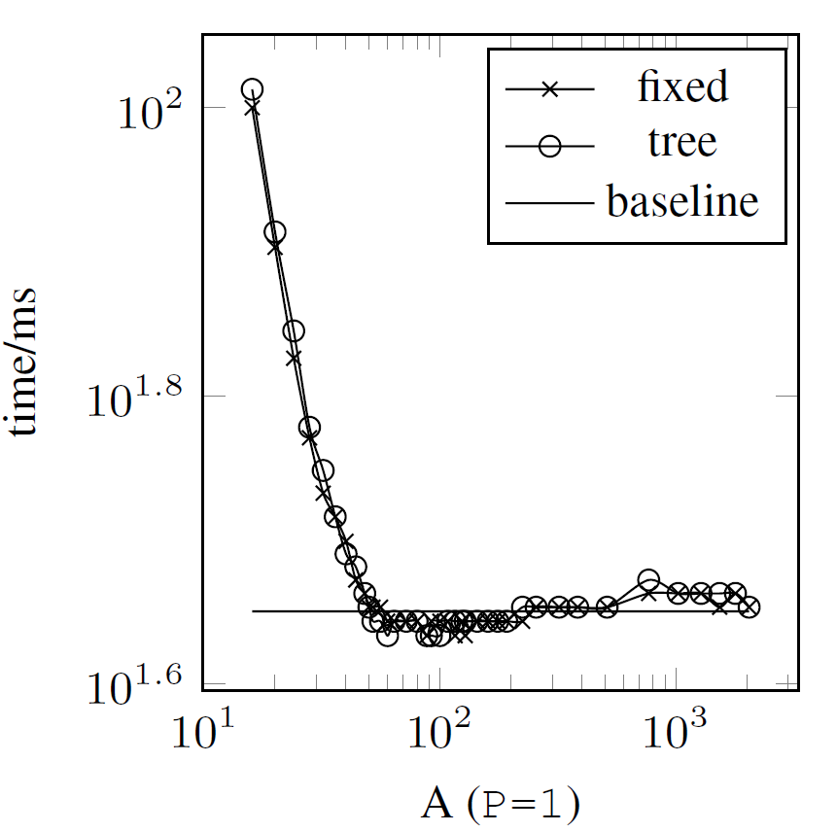
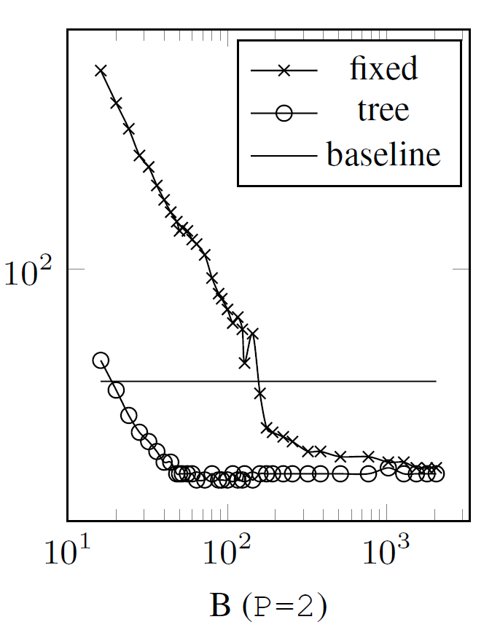
Fixed-size batching - contention

Slide 30
Factoring, GSS, TS
Batch size varies.
progress
cycles
N
Pros: lightweight
Cons: contention

Slide 31
Task-based work-stealing
cycles
N
0..2
2..4
4..8
8..16

Slide 32
Task-based work-stealing
cycles
N
0..2
2..4
4..8
8..16
8..16
4..8
2..4
T0
0..2
T1

Slide 33
Task-based work-stealing
cycles
N
0..2
2..4
4..8
8..16
8..16
steal – a rare event
4..8
2..4
T0
0..2
T1

Slide 34
Task-based work-stealing
cycles
N
0..2
2..4
4..8
8..16
8..16
4..8
12..16
2..4
10..12
T0
0..2
T1
8..10

Slide 35
Task-based work-stealing
cycles
N
0..2
2..4
4..8
8..16
8..16
4..8
12..16
2..4
10..12
T0
0..2
T1
8..10
Pros: can be adaptive - uses stealing information
Cons: heavyweight - minimum batch size much larger

Slide 36
Task-based work-stealing
cycles
N
0..2
2..4
4..8
8..16
Cannot be stolen
after T0 starts processing it

Slide 37
Work-stealing tree
T0
0
0
N
owned

Slide 38
Work-stealing tree
T0: CAS
T0
0
0
N
T0
0
50
N
owned
owned

Slide 39
Work-stealing tree
T0: CAS
T0: CAS
T0
0
0
N
T0
0
50
N
…
T0
0
N
N
owned
owned
completed
What about stealing?

Slide 40
Work-stealing tree
T0: CAS
T0: CAS
T0
0
0
N
T0
0
50
N
…
T0
0
N
N
owned
owned
completed
T1: CAS
T0
0
-51
N
stolen

Slide 41
Work-stealing tree
T0: CAS
T0: CAS
T0
0
0
N
T0
0
50
N
…
T0
0
N
N
owned
owned
completed
T1: CAS
T0
0
-51
N
stolen

Slide 42
Work-stealing tree
T0: CAS
T0: CAS
T0
0
0
N
T0
0
50
N
…
T0
0
N
N
owned
owned
completed
T0
0
-51
N
expanded
T0
0
-51
N
stolen
T0
50
50
M
T1
M
M
N
M = (50 + N) / 2

Slide 43
Work-stealing tree
T0: CAS
T0: CAS
T0
0
0
N
T0
0
50
N
…
T0
0
N
N
owned
owned
completed
T0 or T1: CAS
T0
0
-51
N
expanded
T0
0
-51
N
stolen
T0
50
50
M
T1
M
M
N
M = (50 + N) / 2

Slide 44
Work-stealing tree
T0: CAS
T0: CAS
T0
0
0
N
T0
0
50
N
…
T0
0
N
N
owned
owned
completed
T0 or T1: CAS
T0
0
-51
N
expanded
T0
0
-51
N
stolen
T0
50
50
M
T1
M
M
N
M = (50 + N) / 2

Slide 45
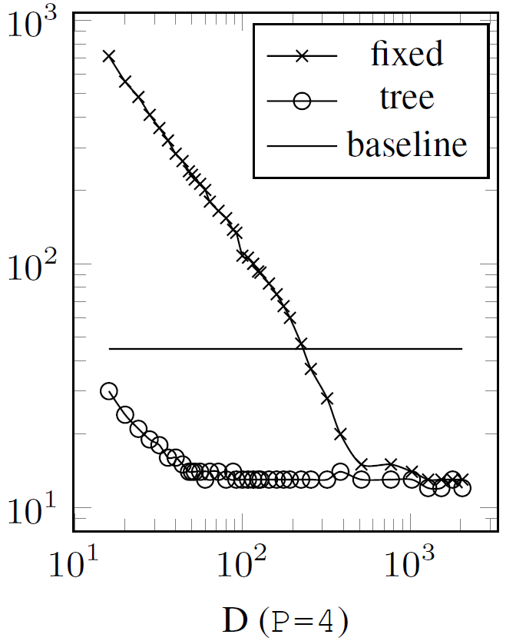
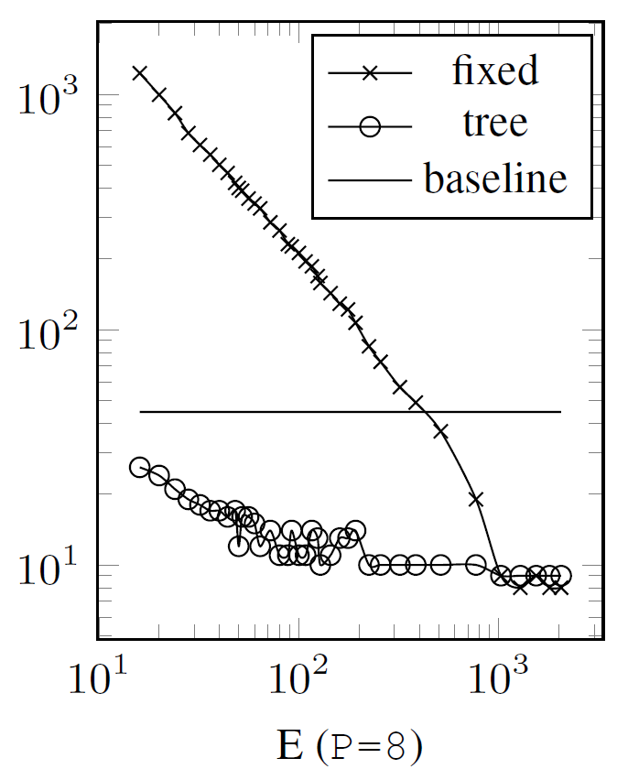
Work-stealing tree - contention

Slide 46
Work-stealing tree scheduling
find either a non-expanded, non-completed node
T0
0
-51
100
T0
50
50
100
T1
75
75
100

Slide 47
Work-stealing tree scheduling
find either a non-expanded, non-completed node
if not found, terminate
T0
0
100
100

Slide 48
Work-stealing tree scheduling
find either a non-expanded, non-completed node
if not found, terminate
if not owned, steal and/or expand, and descend
T1: CAS
T1: CAS
T0
0
-51
N
expanded
T0
0
-51
N
stolen
T0
50
50
M
T1
M
M
N

Slide 49
Work-stealing tree scheduling
find either a non-expanded, non-completed node
if not found, terminate
if not owned, steal and/or expand, and descend
advance until node is completed or stolen
T0: CAS
T0: CAS
T0
0
0
N
T0
0
50
N
…
T0
0
N
N
owned
owned
completed

Slide 50
Work-stealing tree scheduling
find either a non-expanded, non-completed node
if not found, terminate
if not owned, steal and/or expand, and descend
advance until node is completed or stolen
go to 1)

Slide 51
Work-stealing tree scheduling
find either a non-expanded, non-completed node
find either a non-expanded, non-completed node
if not found, terminate
if not owned, steal and/or expand, and descend
advance until node is completed or stolen
go to 1)

Slide 52
Choosing the node to steal
Find first, in-order traversal
3
5
2
9

Slide 53
Choosing the node to steal
Find first, in-order traversal
3
5
2
9
Catastrophic – a lot of stealing, huge trees

Slide 54
Choosing the node to steal
Find first, in-order traversal
Find first, random order traversal
3
3
5
5
2
9
2
9
Catastrophic – a lot of stealing, huge trees

Slide 55
Choosing the node to steal
Find first, in-order traversal
Find first, random order traversal
3
3
5
5
2
9
2
9
Catastrophic – a lot of stealing, huge trees
Works reasonably well.

Slide 56
Choosing the node to steal
Find first, in-order traversal
Find first, random order traversal
Find most elements
3
3
3
5
5
5
2
9
2
9
2
9
Catastrophic – a lot of stealing, huge trees
Works reasonably well.
Generates least nodes.
Seems to be best.

Slide 57
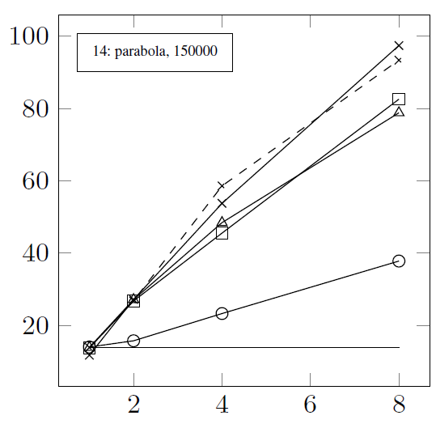
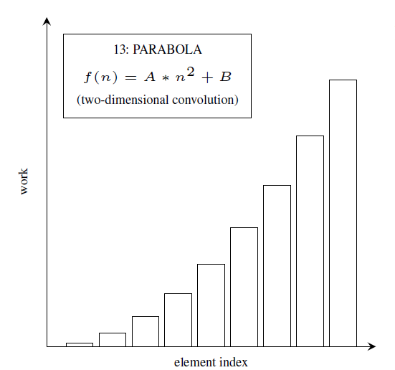
Comparison with fixed-size batching

Slide 58
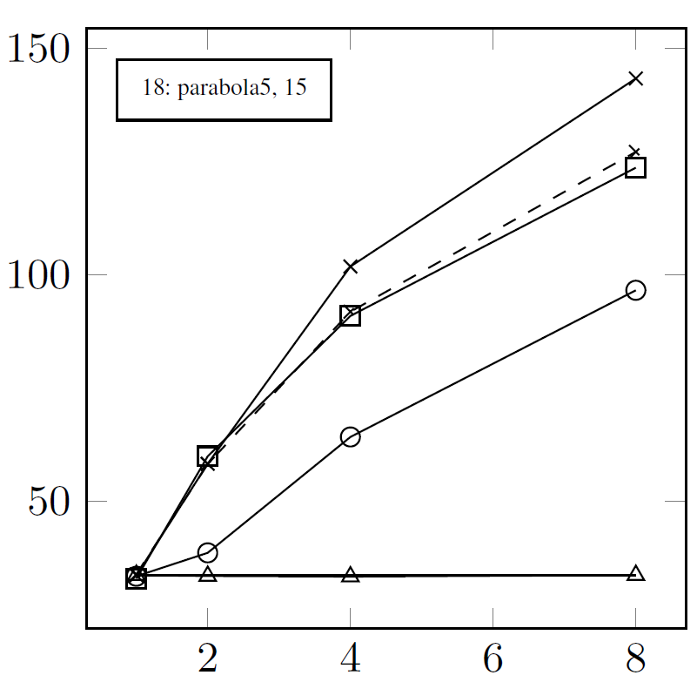
Comparison with fixed-size batching

Slide 59
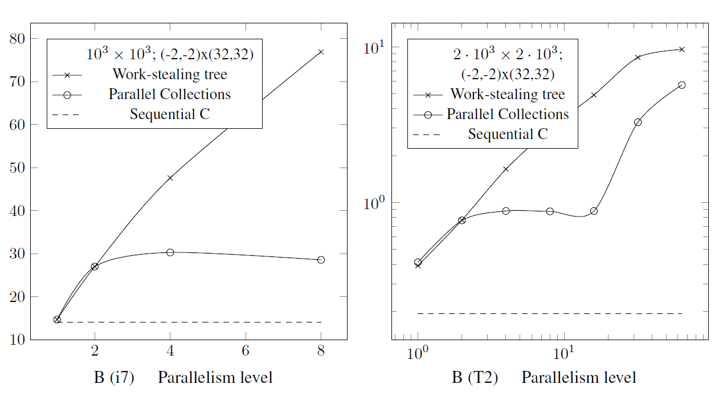
Comparison with task work-stealing

Slide 60
Thank you! Questions?

Slide 61
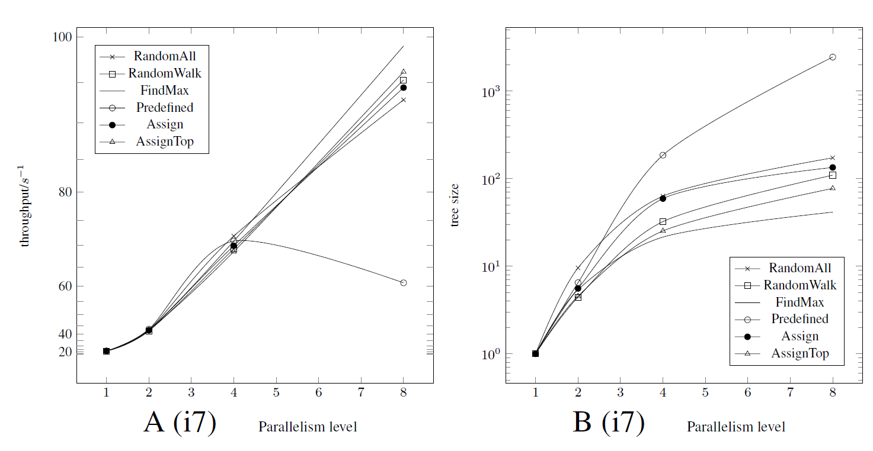
Finding work

Slide 62
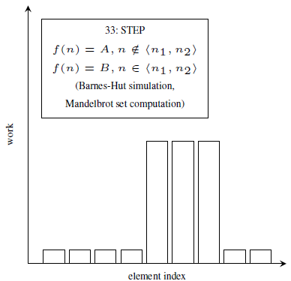
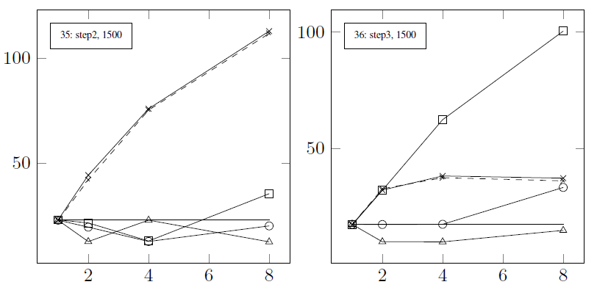
Other workloads

